Slide 1
随机接入MAC协议

Slide 2
MAC Protocols: a taxonomy
Three broad classes:
Channel Partitioning
divide channel into smaller “pieces” (time slots, frequency, code)
allocate piece to node for exclusive use
Random Access
channel not divided, allow collisions
“recover” from collisions
“Taking turns”
nodes take turns, but nodes with more to send can take longer turns

Slide 3
Random Access Protocols
When node has packet to send
transmit at full channel data rate R.
no a priori coordination among nodes
two or more transmitting nodes ➜ “collision”,
random access MAC protocol specifies:
how to detect collisions
how to recover from collisions (e.g., via delayed retransmissions)
Examples of random access MAC protocols:
slotted ALOHA
ALOHA
CSMA, CSMA/CD, CSMA/CA

Slide 4
Slotted ALOHA
Assumptions:
all frames same size
time divided into equal size slots (time to transmit 1 frame)
nodes start to transmit only slot beginning
nodes are synchronized
if 2 or more nodes transmit in slot, all nodes detect collision
Operation:
when node obtains fresh frame, transmits in next slot
if no collision: node can send new frame in next slot
if collision: node retransmits frame in each subsequent slot with prob. p until success

Slide 5
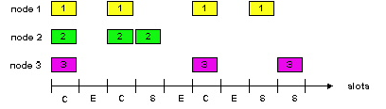
Slotted ALOHA
Pros
single active node can continuously transmit at full rate of channel
highly decentralized: only slots in nodes need to be in sync
simple
Cons
collisions, wasting slots
idle slots
nodes may be able to detect collision in less than time to transmit packet
clock synchronization

Slide 6
Slotted Aloha efficiency
Efficiency : long-run fraction of successful slots (many nodes, all with many frames to send)
max efficiency: find p* that maximizes Np(1-p)^{N-1}
for many nodes, take limit of Np*(1-p*)^{N-1} as N goes to infinity, gives:
Max efficiency = 1/e = .37
suppose: N nodes with many frames to send, each transmits in slot with probability p
prob that given node has success in a slot = p(1-p)^{N-1}
prob that any node has a success = Np(1-p)^{N-1}
!
At best: channel used for useful transmissions 37% of time!

Slide 7
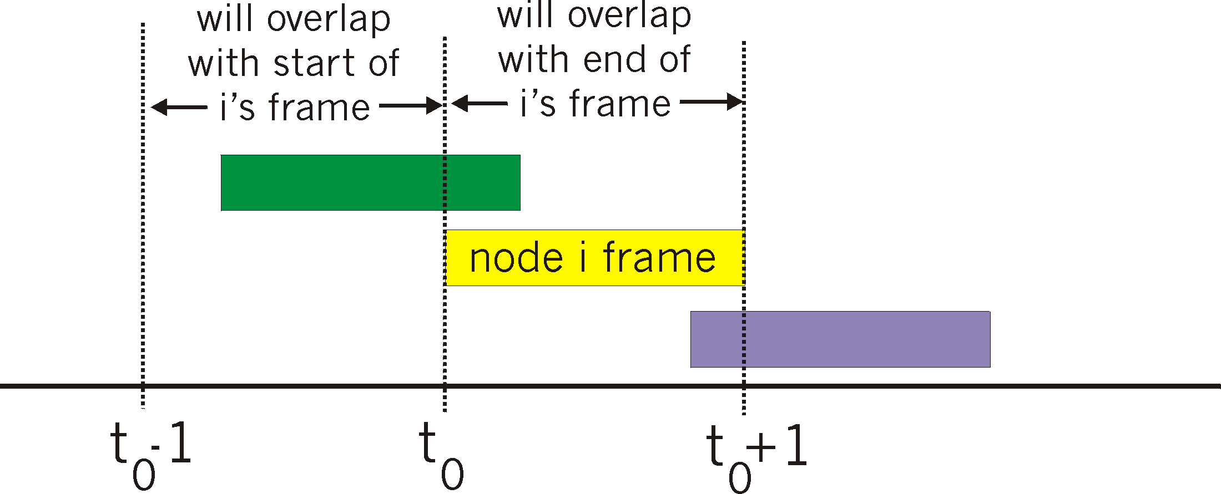
Pure (unslotted) ALOHA
unslotted Aloha: simpler, no synchronization
when frame first arrives
transmit immediately
collision probability increases:
frame sent at t₀ collides with other frames sent in [t₀-1,t₀+1]

Slide 8
Pure Aloha efficiency
P(success by given node) =
P(node transmits) .
P(no other node transmits in [p₀-1,p₀] .
P(no other node transmits in [p₀-1,p₀]
= p . (1-p)^{N-1 .} (1-p)^{N-1}
= p . (1-p)^{2(N-1)}
… choosing optimum p and then letting n -> infty ... ^{= 1/(2e) = .18}
even worse than slotted Aloha!

Slide 9
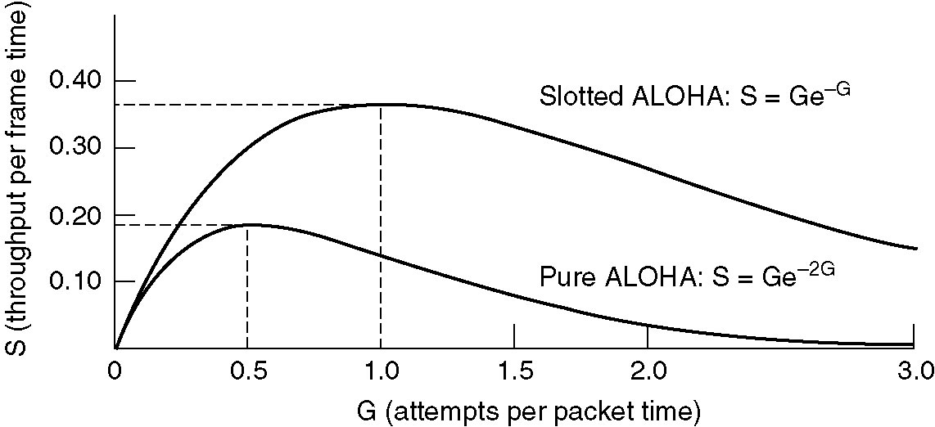
Pure ALOHA
Throughput versus offered traffic for ALOHA systems.

Slide 10
CSMA (Carrier Sense Multiple Access)
CSMA: listen before transmit:
If channel sensed idle: transmit entire frame
If channel sensed busy, defer transmission
human analogy: don’t interrupt others!

Slide 11
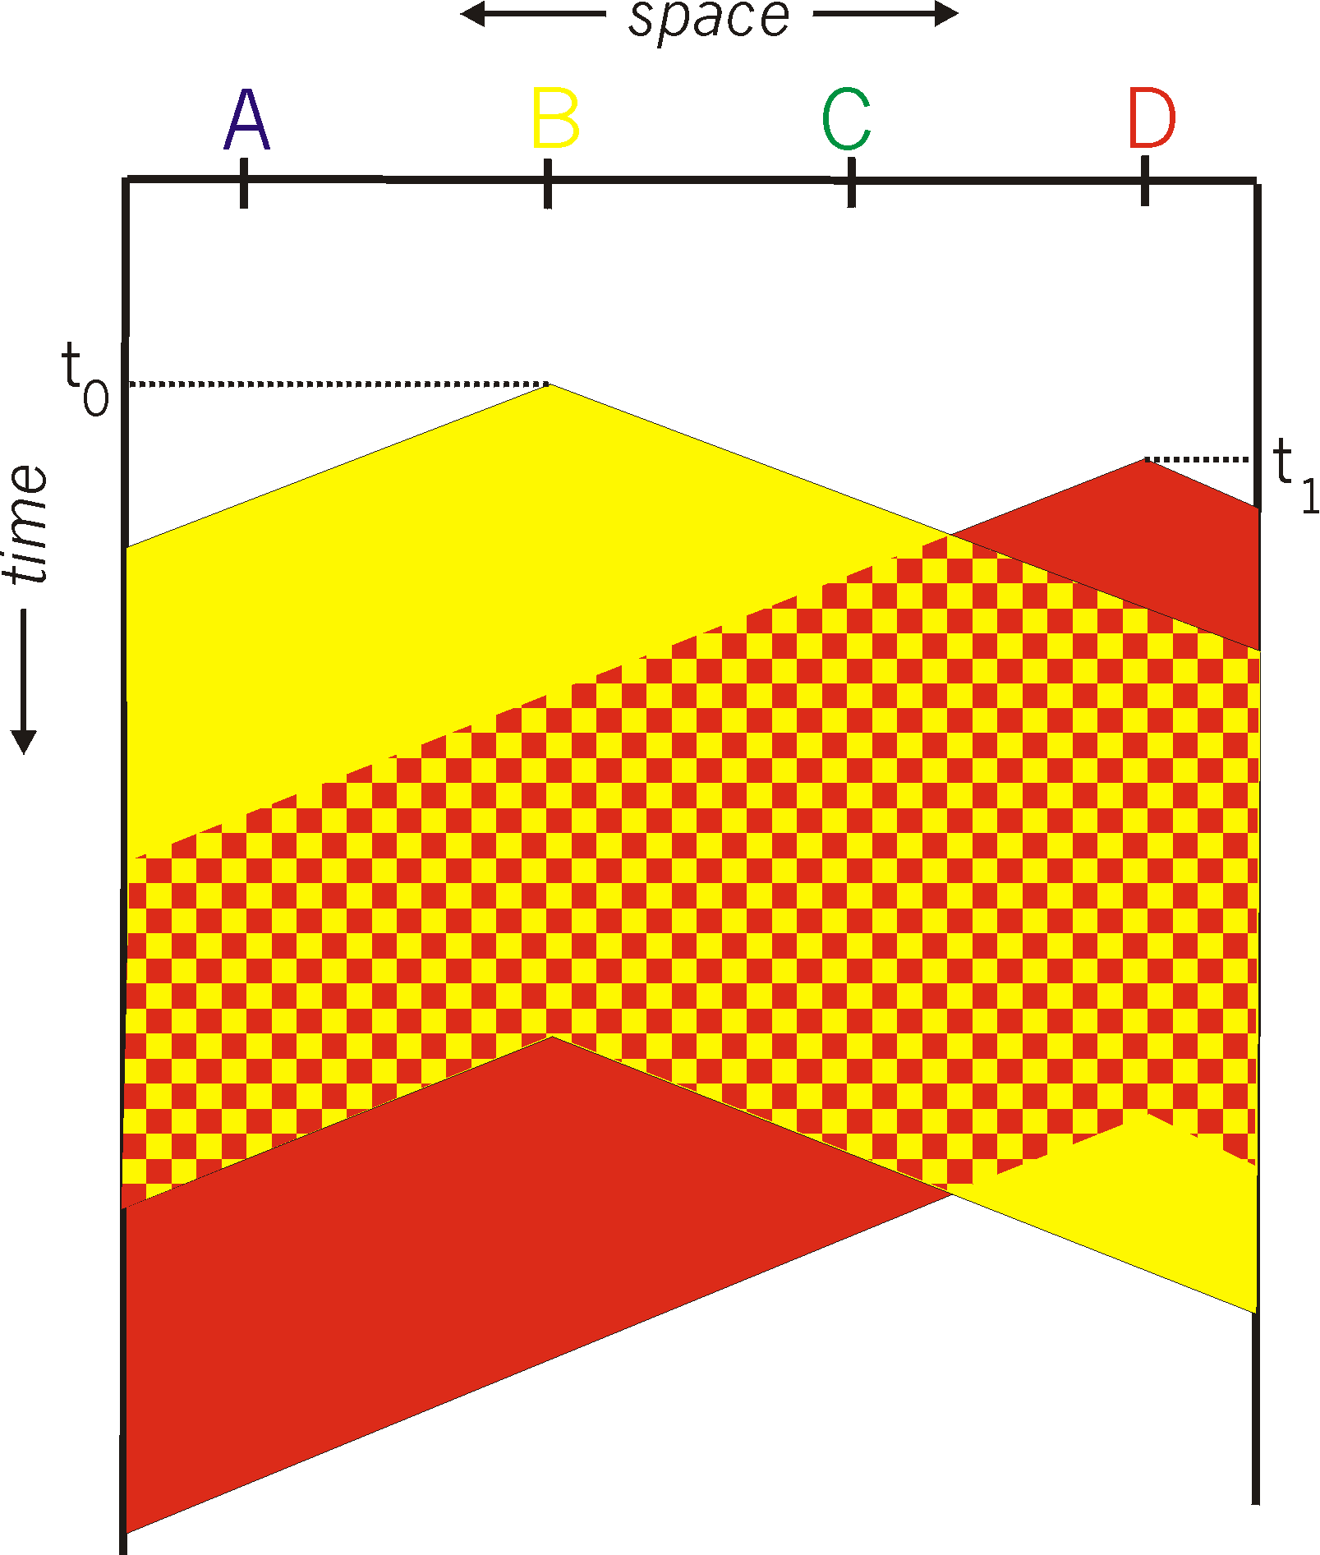
CSMA collisions
collisions can still occur:
propagation delay means two nodes may not hear each other’s transmission
collision:
entire packet transmission time wasted
note:
role of distance & propagation delay in determining collision probability

Slide 12
Nonpersistent CSMA
If medium is idle, transmit; otherwise, go to 2
If medium is busy, wait amount of time drawn from probability distribution (retransmission delay) and repeat 1
Random delays reduces probability of collisions
Consider two stations become ready to transmit at same time
While another transmission is in progress
If both stations delay same time before retrying, both will attempt to transmit at same time
Capacity is wasted because medium will remain idle following end of transmission
Even if one or more stations waiting
Nonpersistent stations deferential

Slide 13
1-persistent CSMA
To avoid idle channel time, 1-persistent protocol used
Station wishing to transmit listens and obeys following:
If medium idle, transmit; otherwise, go to step 2
If medium busy, listen until idle; then transmit immediately
1-persistent stations selfish
If two or more stations waiting, collision guaranteed
Gets sorted out after collision

Slide 14
P-persistent CSMA
Compromise that attempts to reduce collisions
Like nonpersistent
And reduce idle time
Like1-persistent
Rules:
If medium idle, transmit with probability p, and delay one time unit with probability (1 – p)
Time unit typically maximum propagation delay
If medium busy, listen until idle and repeat step 1
If transmission is delayed one time unit, repeat step 1
What is an effective value of p?

Slide 15
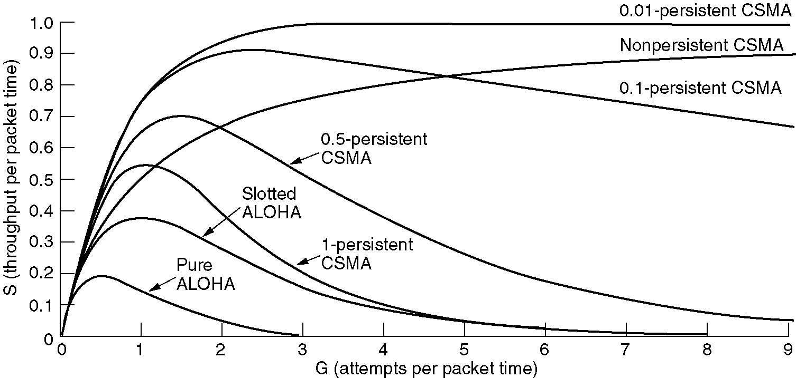
Persistent and Nonpersistent CSMA
Comparison of the channel utilization versus load for various random access protocols.

Slide 16
CSMA/CD (Collision Detection)
CSMA/CD: carrier sensing, deferral as in CSMA
collisions detected within short time
colliding transmissions aborted, reducing channel wastage
collision detection:
easy in wired LANs: measure signal strengths, compare transmitted, received signals
difficult in wireless LANs: received signal strength overwhelmed by local transmission strength
human analogy: the polite conversationalist

Slide 17
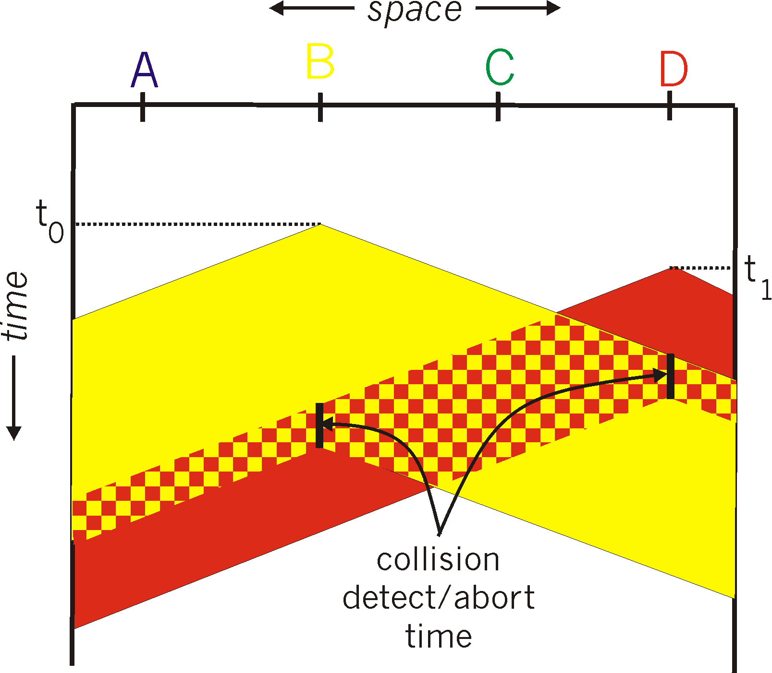
CSMA/CD collision detection

Slide 18
CSMA/CD (Collision Detection)
With CSMA, collision occupies medium for duration of transmission
Stations listen whilst transmitting
If medium idle, transmit, otherwise, step 2
If busy, listen for idle, then transmit
If collision detected, jam then cease transmission
After jam, wait random time then start from step 1

Slide 19

Summary
ALOHA
CSMA, CSMA/CD, CSMA/CA

